Slide 1

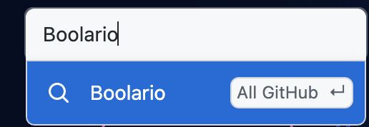

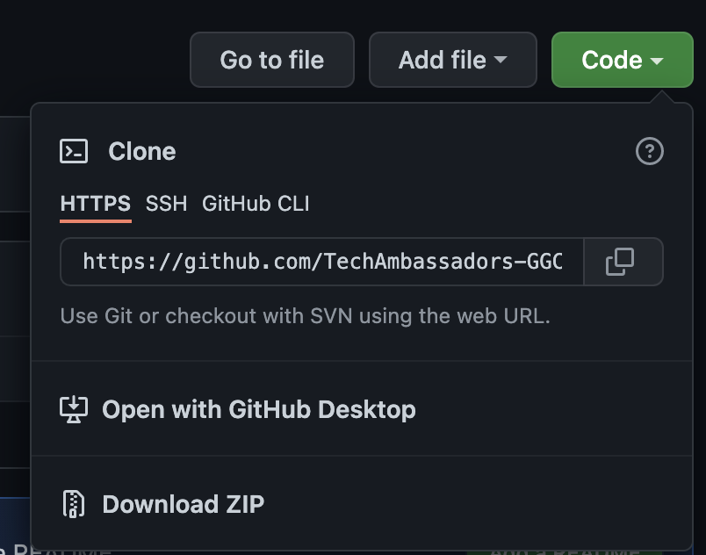
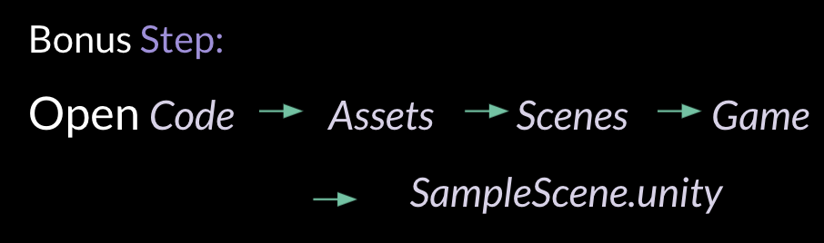
INSTRUCTIONS
Step 1: Log into GGC Computer
Step 2: Google Github - Search Boolario
Step 3: Click on Code , Download ZIP
Step 4: Right Click on file, Extract
Step 5: Open Unity Hub Unity Hub UnityHub.exe
Download. Make an Account.
Step 6: In the top right corner, click the profile & sign in
Step 7: Click create new account (blue font color)
Step 8: After account is created, click profile in Unity Hub again
Step 9: Click manage account
Step 10: Click activate license

Slide 2
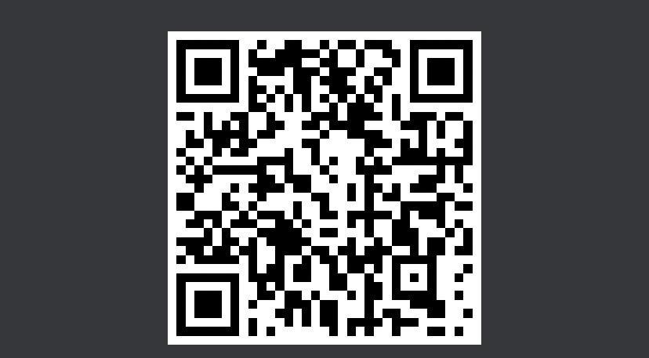
Before we get started…..
Pre-Workshop Survey QR Code:

Slide 3
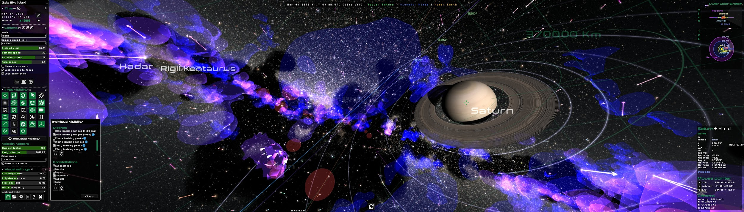
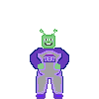
BOOLARIO
Khamilah Nixon, Anya Solodky, Austin Mathews

Slide 4

TAP Introduction

Slide 5


Who are We?
We’re all Software Development Students at GGC
Khamilah Nixon - Website and Game Developer
Anya Solodky - Graphics, Map & Sound Designer
Austin Mathews - Game Developer

Slide 6
What is TAP?
Technology Ambassador Program aims to teach students learn how to develop themselves in a professional environment, as well as inspire non-IT students to consider and encourage IT students to broaden their horizons in IT.
Project and research-based class at GGC
Counts as a STEC 4800: Intern in Service-Learning
TAP is not limited to only IT minds; Welcomes non-IT students as well.

Slide 7

Target audience
Our audience is anyone who wants to learn!
But, TAP targets specifically these groups:
01 | Prospective IT Students
02 | Children - Super Saturdays Series
03 | Undecided-Major College Students
04 | Adults who are unfamiliar with IT concepts
05 | Women and minority groups

Slide 8
Project Description

Slide 9

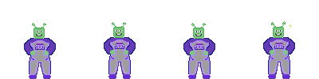
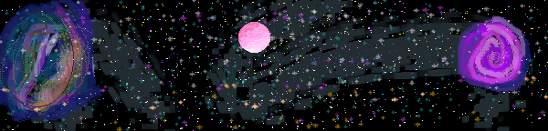
What is Boolario?
Boolario is a 2D side-scroller game built to educate non-IT students about programming and game development concepts.
By collecting TRUE and FALSE coins, the player can attempt to make the displayed logic statement correct, which will award them a point.
After playing Boolario, users will gain an understanding of logic statements, boolean values, and other coding and game development concepts.

Slide 10

Goals

Slide 11
Project Goals and Expectations
Build an innovative learning experience
Get people interested in IT!
Help develop an understanding of Game Dev concepts & Boolean Values
Overall Expectation:
After completion, the expectation is for attendees to have a basic understanding of game development and programming concepts.
More specifically, our team hopes that students will understand hitboxes, boolean values, and iteration.
Notes:
With the project our team has built, we hope to achieve success in building an innovative learning experience to offer to anyone as well as prospective IT students.

Slide 12

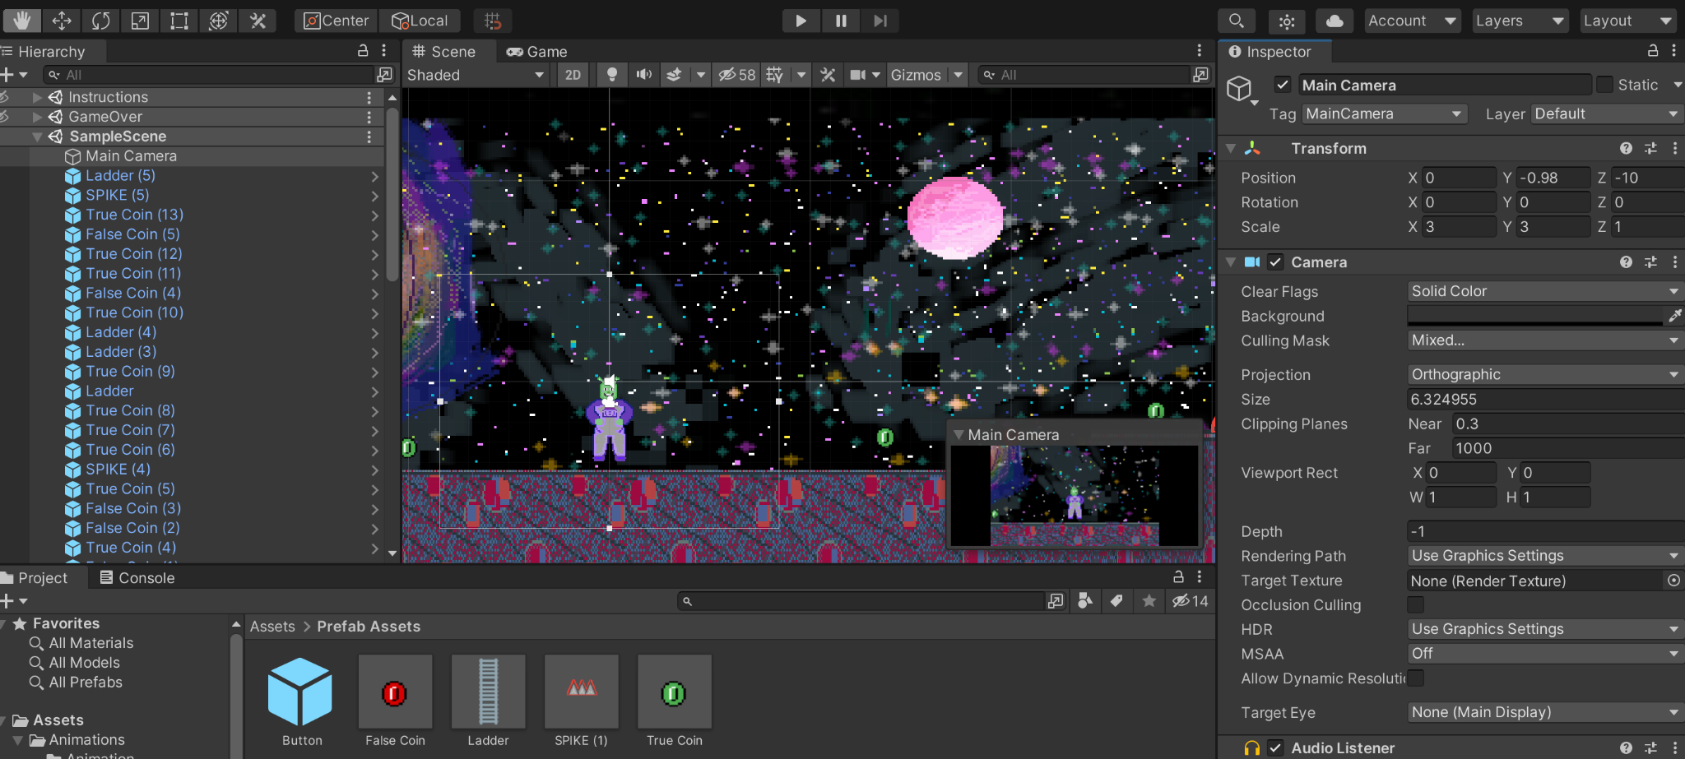
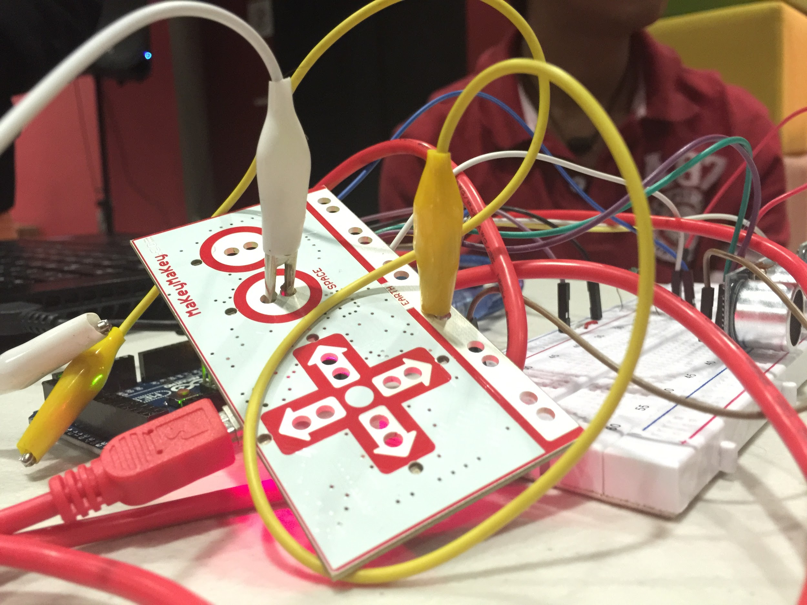
Implemented Technologies
Technologies utilized to build Boolario:
Unity - Game Engine
C# - Programming Language via VS Code
Makey Makey - Microcontroller (Whether or not utilized depends on the setting)

Slide 13

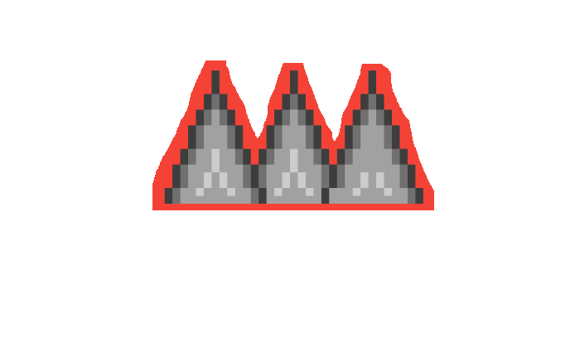
Workshop

Slide 14

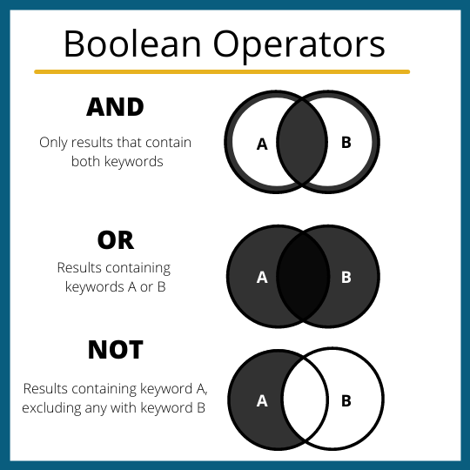
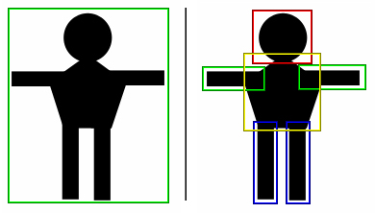

Jumping into it - Lessons
Booleans
Boolean values are containers that can hold 2 values: TRUE and FALSE
Unity framework
Unity is a popular game engine that allows developers to create 2D and 3D programs
1
3
Hitboxes
Hitboxes are invisible shapes in game engines that determine object collisions
4
Iterations
An iteration is a process in which instructions are repeated a definite or indefinite number of times
2
Notes:
Go through and explain these concepts here!

Slide 15

Boolario Website
http://boolario.altervista.org
Click on Workshop
Notes:
Should we keep this ?? :/

Slide 16
Initial Game Testing

Slide 17
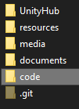
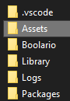
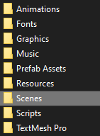
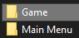
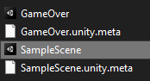
Testing the Game: Loading the Game
Open the Boolario folder -> code -> Assets -> Scenes -> Game -> SampleScene.unity

Slide 18
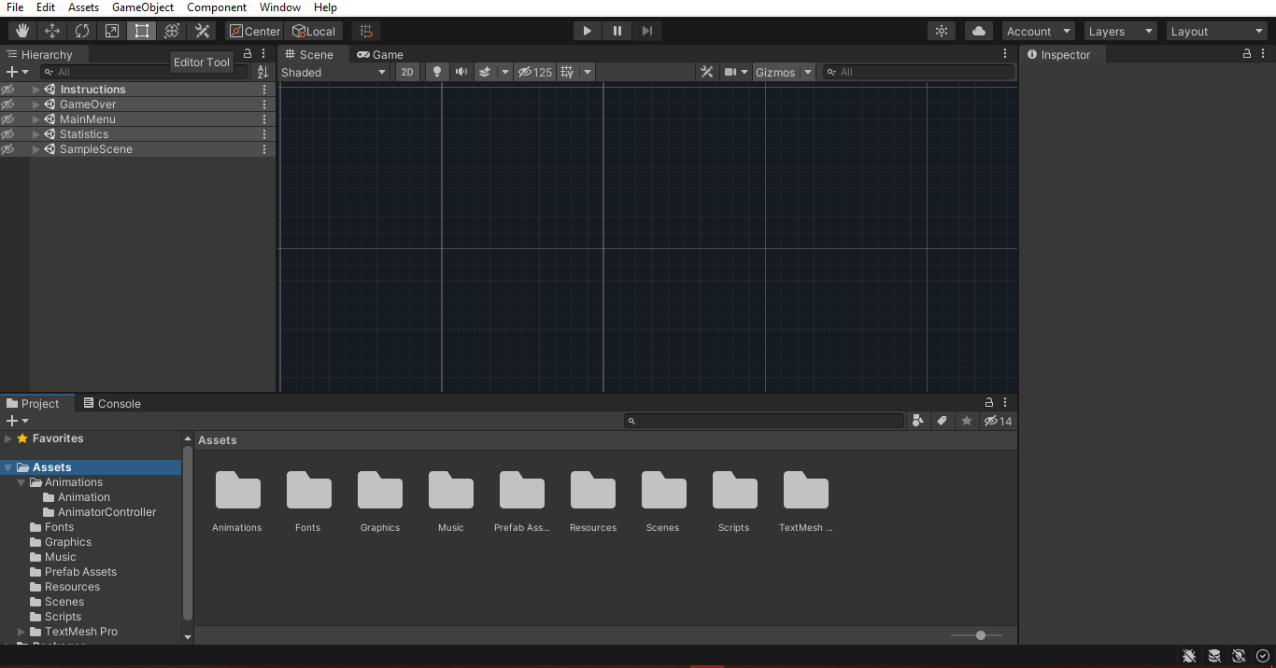
Testing the Game: Identify the Issues
Click on the play button at the top of the screen. (Allow the program a few seconds to load)
Use A and D keys or left and right arrow keys to move Boolario and spacebar to jump
Press the play button again to exit play mode

Slide 19
Applying Hitboxes

Slide 20
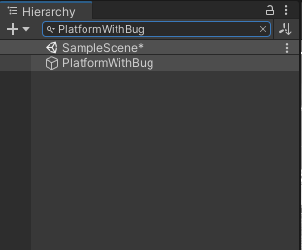
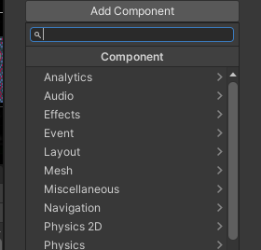
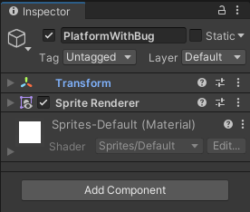
Hitboxes: Create a 2D Box Collider Part 1
On the right side of the screen under, Inspector, scroll down to the bottom of the screen.
On the left side of the screen under, Hierarchy, search for PlatformWithBug in the Search Box
Click Add Component

Slide 21
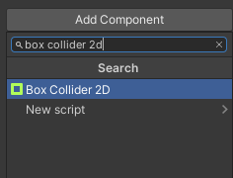
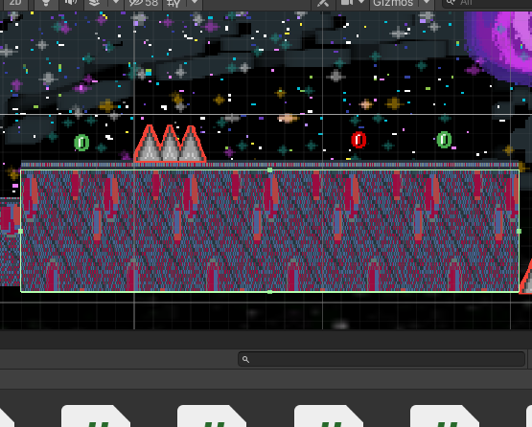
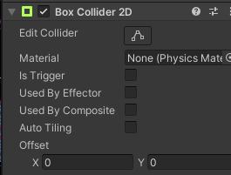
Hitboxes: Create a 2D Box Collider Part 2
Click on the Box Collider 2D options that appears and click Edit Collider
In the search bar, type in Box Collider 2D
Click and drag the green square anchors around the platform to outline the platform.

Slide 22
Hitboxes: Testing Your Changes
Click on the Edit Collider button to exit the collider editor
Click the Play button on top of the scene. (Allow the program a few seconds to load)
Use D and A keys or left and right arrow keys to move Boolario and spacebar to jump
Press the play button again to exit play mode

Slide 23
Changing the Jump Height

Slide 24
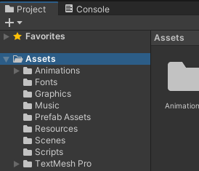
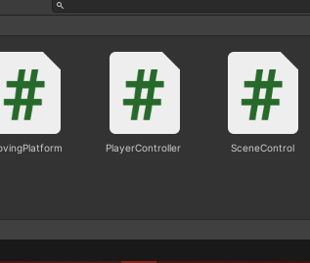
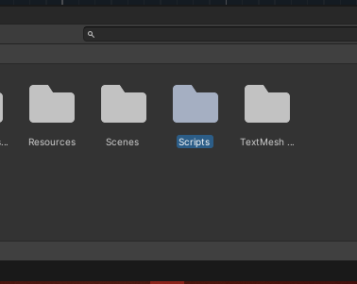
Increase Jump Height: Open Script File
Open the “Scripts” folder
Click on the “Assets” folder
Open the “PlayerController” file
Notes:
Beautiful Job Khamilah!!

Slide 25
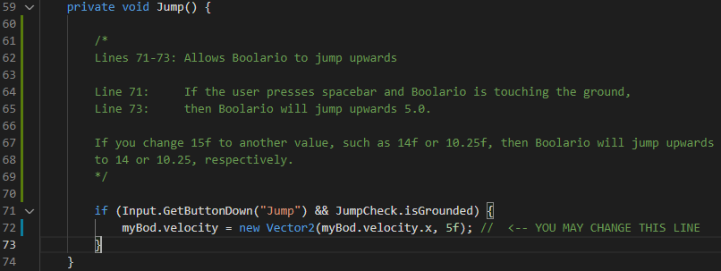
Increase Jump Height: Open Script File
A program called Visual Studio Code will open
Scroll down to lines 59-74
3. Change the ‘5’ in line 72 to ‘15’
4. Press Ctrl + S to save the file
Notes:
Great job Khamilah!

Slide 26
Increase Jump Height: Test New Jump Height
Go back to Unity
Allow Unity to process your changes
Press the play button to test your changes
Press the play button again to exit play mode
Notes:
Great job Khamilah!

Slide 27
You’re done!

Slide 28

Survey

Slide 29

Survey
We would love to hear your feedback!
Tell us how we did today, and take our survey!
Your answers will be anonymous.

Slide 30
Thank you!
Any Questions?

Slide 31
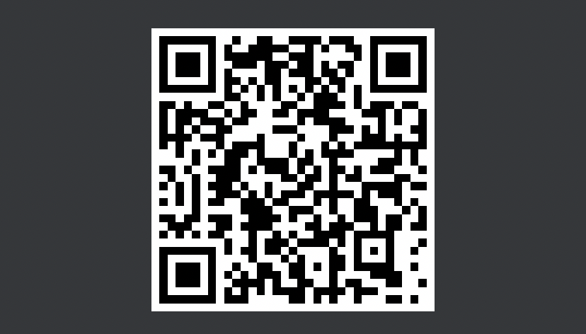
Thank you for joining us on this workshop! We’d appreciate if you give us feedback in a post-workshop survey!

Slide 32
Fin

